Slide 1
Skip Lists, Trie
Chaklam Silpasuwanchai
July 15, 2019

Slide 2
Readings
https://en.wikipedia.org/wiki/Trie
https://en.wikipedia.org/wiki/Skip_list
Charles Lieserson and Erik Demaine, MIT CourseWare - https://ocw.mit.edu/courses/electrical-engineering-and-computer-science/6-046j-introduction-to-algorithms-sma-5503-fall-2005/

Slide 3
Skip Lists
Pugh 1989
Dynamic Search Structure
e.g., Red Black Trees, AVL Trees, B-Trees, Treaps
Efficient, Simple, Randomized
Guarantees O(lg N) in expected time with high probability (1 - (1/n^{x}))
That is, if one use skip lists to do a polynomial number of operations, every single one of them will perform O(lg n)

Slide 4
Skip Lists
Recall that Linked Lists take O(n) for search. Not so good! How to fix it?
Let’s talk about train system in Japan. In some line, there is a express train that skip certain stations to reach the destination. But at that very same line, there is also train that goes through all stations in the line. This can be achieved by having multiple tracks
If you want to quickly go to certain station X, one can take the express train to the nearest station to X, then take local train to X
Express Line and Local Line

Slide 5
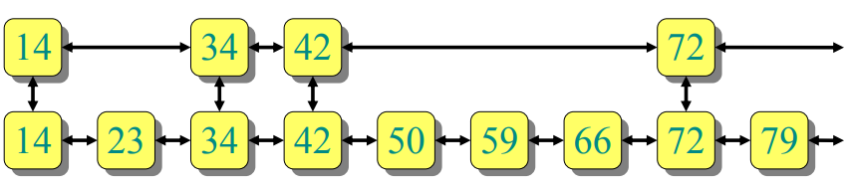
Skip Lists
In Skip Lists, we maintain two linked lists, one is the Local List, which traverse through whole list. Then we also have a Express List that only goes through certain elements. Then we put links between Express List and Local List
Thus in Skip Lists, there contains three components
L₁ (Local): Stores every element
L₂ (Express/Skip): Stores some element
How to choose which element to store?
Links between Linked L₁ and L₂

Slide 6
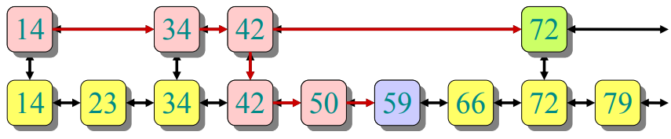
Skip Lists - Search
To search for X, start with the Express List, go right until going right would go too far, go back one element, then exchange to the Local List, and go right until you find the element X (or >X in which you will know X does not exist)
As you can see, whether how fast this algorithm can work really depends on what element you store at Express List
So if you are the designer of this system, which element (or station) you will select for the Express List?

Slide 7
Skip Lists
What keys go in Express List?
Best is spread them out uniformly, so to increase the probability of success (equal partitions)
Then in worst case, cost of search = |L₂(Express)| + |L₁(Local)| / |L₂(Express)|
How to minimize this cost of search?
Let n = |L₁| because it stores every element
Minimize |L₂| + n / |L₂|
It is clearly best to have small |L₂| for the first part of the equation, but then there is a tradeoff in the second part of the equation. Thus the best is balancing L₂
To balance, up to constant factors, let |L₂| = n / |L₂|
|L₂|² = n → L₂ = √n
So the cost of search = √n + n/√n = 2√n
Thus for optimal search, for every √n, there will be a express station

Slide 8
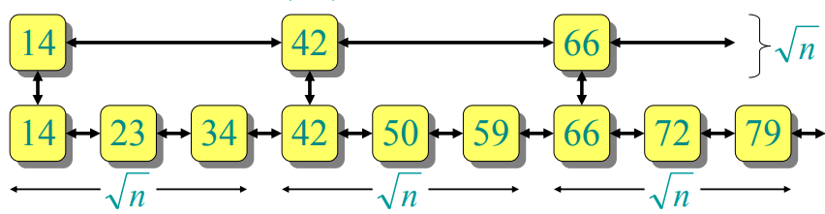
Skip Lists

Slide 9
Skip Lists - Search
So now….we got 2√n, but we haven’t reached the dreamland of O(lg n) for search operation
What to do next?
This is obvious, but yah...add more express lines! A super express line, the one that is even faster than the express line
Then by intuition, we know the cost of search is 3∛n
Let’s think about k number of express line which is k * ^{k}√n
So what’s a good k? lg n → lg n * ^{lg n}√n → lg n * 2 → Θ (lg n)
If we have lg n lists, ex., 9 elements, log 9 > 3, thus there will be total of 4 lists including the Local List. What is the ratio between the 3rd Express Line and 2nd,2nd and 1st, and 1st and the Local List?
The ratio between should be the same, and the product of these ratio should be n. Since there are log n lists, the ratio will be r^{lgn} = n, where r = 2. Thus it means I want half on the 1st Express Line, I want quarter on the 2nd Express Line and eighth on the 3rd Express Line, and so on

Slide 10
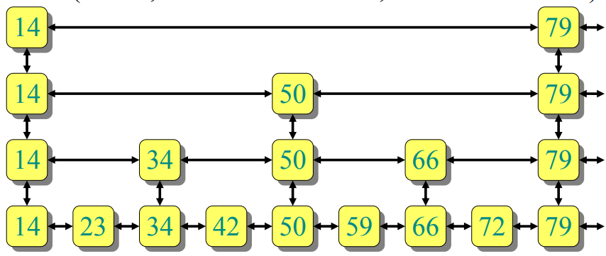
Skip List - Ideal Skip List
Thus, the 1st Express Line will get ⎡9/2⎤ = 5 elements
The 2nd Express Line will get ⎡5/2⎤ = 3 elements and son on. This indeed looks like a binary tree!

Slide 11
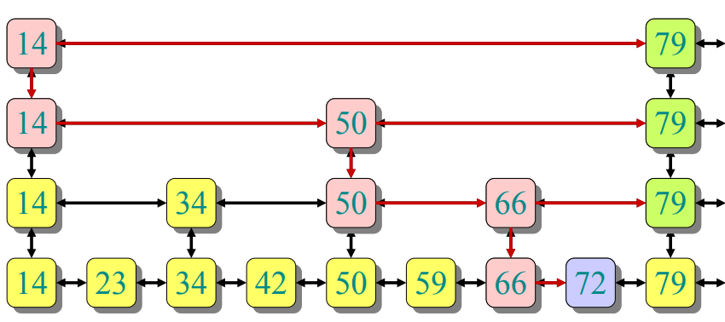
Skip List - Search 72
There are log n list, and each list it takes roughly 2 steps (half) thus the search complexity takes 2 log n

Slide 12
Skip List - Maintain Structure
Let’s talk about maintaining the structure when insertion happens
To insert an element x into a skip list:
Search(x) to see where x fits in bottom list
Always insert into bottom list because bottom list should contains all elements
Inserting one may not affect the skip list, but the more you insert, it will affect your skip list performance
Thus we have to decide which Express List contains our x
Idea is flip the coin, if it comes out head, promote x to the next level and flip again. If not, we stop. The key is that this fair coin will keep the expected ratio to be half because the probability is half
On average
½ of the elements promoted 0 levels
¼ of the elements promoted 1 level
⅛ of the elements promoted 2 levels
etc

Slide 13
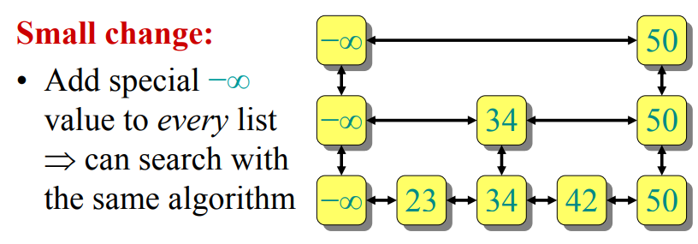
Skip List - Maintain Structure

Slide 14
Skip List -
For delete, just search for x, and delete from all lists.
Yah, that’s it

Slide 15
Trie

Slide 16
Trie
A prefix-based tree-like data structure for storing strings
A string/prefix can be retrieved by traversing down the tree
Use for “retrieval” of data thus the name Trie (pronounced: try)
String processing has many real-world applications such as search engines, genome analysis, data analytics, etc

Slide 17
Trie
TrieNode{
hashmap<Character, TrieNode> children;
boolean endOfWord = false
}

Slide 18
Trie - Insertion
During insertion
When a node does not exist, create the node and mark as F
When a node exist,
the character does not exist, add the character
the character exist, traverse down
At n+1 node, mark endOfWord true

Slide 19
Trie - Insertion
root
a
F

Slide 20
Trie - Insertion
root
Insert “abc”
a
F
b
F
c
F
T
True marks the end of the word, which will help facilitate our search later on

Slide 21
Trie - Insertion
root
Insert “abgl”
a
F
b
F
c g
l
F
F
T
T

Slide 22
Trie - Insertion
root
Insert “cdf”
a c
F
d
b
F
F
f
c g
F
l
F
F
T
T
T

Slide 23
Trie - Insertion
root
Insert “cd”
a c
F
d
b
F
F
f
c g
T
l
F
F
T
T
T

Slide 24
Trie - Search
root
Search “ab”
a c
F
d
return false
b
F
F
f
c g
T
l
F
F
T
T
T

Slide 25
Trie - Search
root
Search “abc”
a c
F
d
return true
b
F
F
f
c g
T
l
F
F
T
T
T

Slide 26
Trie - Deletion
During deletion
If the delete key does not exist, no modification is done
If the delete key is unique and does not share any prefix with others (i.e., all nodes along the path contains at most 1 character), delete all nodes
If the delete key is prefix of another longer key, mark F on the n+1 node
If the delete key shares prefix with another key, delete nodes from end of key until the first leaf node of the longest prefix key

Slide 27
Trie - Delete
root
Delete “abc”
a c
F
d
b
F
F
f
c g
T
l
F
F
T
T
T

Slide 28
Trie - Delete
root
Delete “abgl”
a c
F
d
b
F
F
f
g
T
l
F
F
T
T

Slide 29
Trie - Delete
root
Delete “cd”
c
F
d
Cannot delete this node because it is not empty. But we can simply set endOfWord to false
F
f
F
T

Slide 30
Trie - Analysis
Words with same prefix will share common ancestors
Insertion and deletion complexity will be average length of all words times number of words
Search complexity will be based on the average length of words
One node can have maximum 26 childrens (alphabets) which leads to the main issue of Trie, i.e., storage problem
If you require prefix lookup / alphabetical order search, go for Tries (e.g., url lookup, dictionary lookup). Otherwise Hash Table is better

